Slide 1
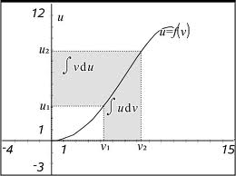
Lesson 3.7
Hello to our MATH 181 Class-Zoom
We will cover Lessons 3.7 & 3.8 today October 25, which will bring us up to date in time for Quiz 4. (Note: Lesson 3.8 is very short.)
Quiz 3 (due Oct 29) covers Lessons 3.1-3.5 which we have already gone over.
Quiz 4 (due Nov 12) covers Lessons 3.6-3.9 so we have plenty of time to cover those sections prior to the Quiz 4 due date.
Thank you for your patience & support.
All my best ~Dr. Beyers

Slide 2
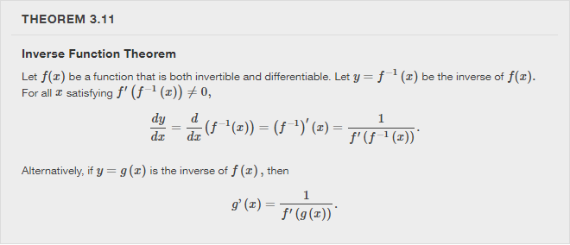
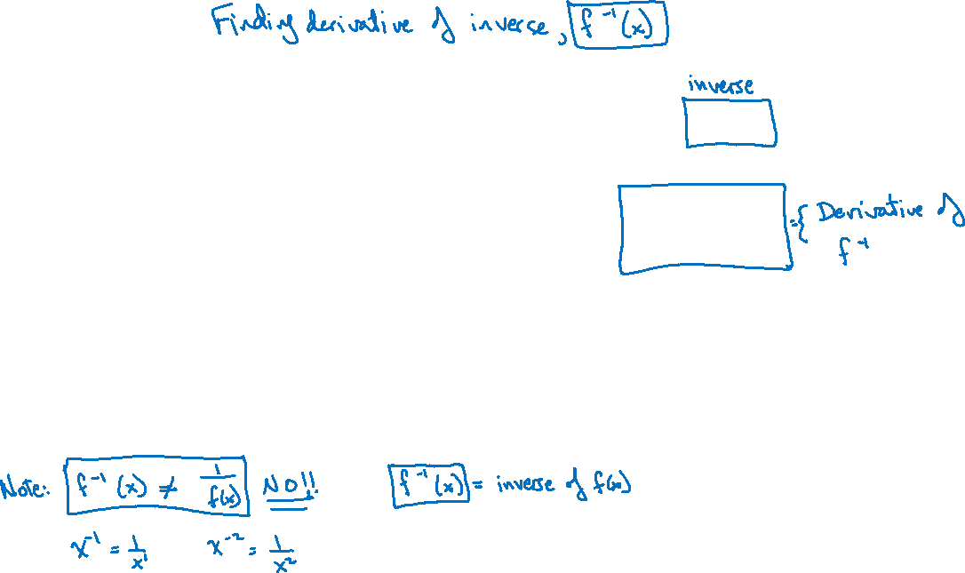

Slide 3
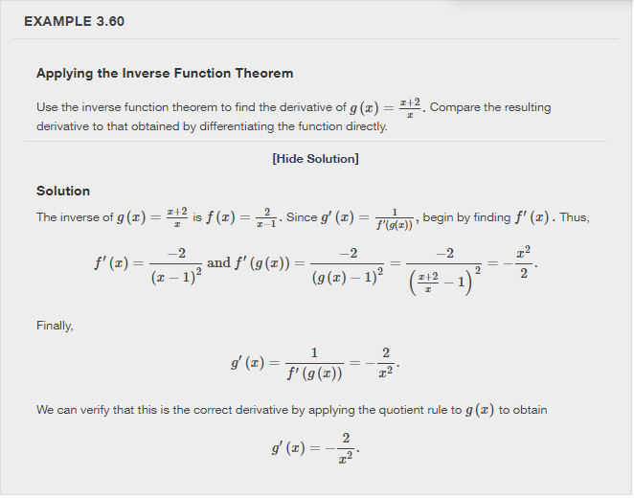
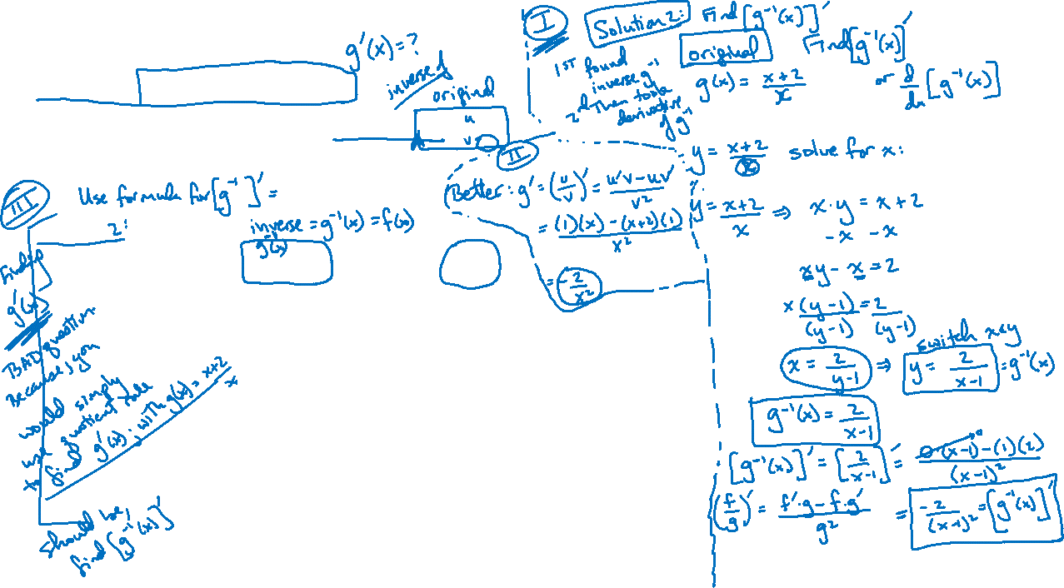

Slide 4
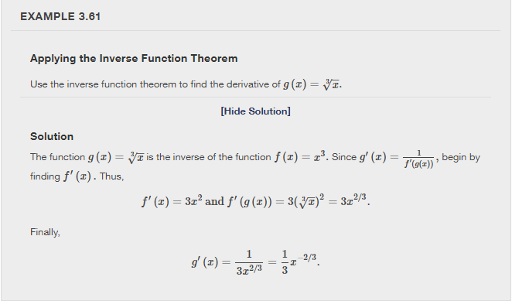
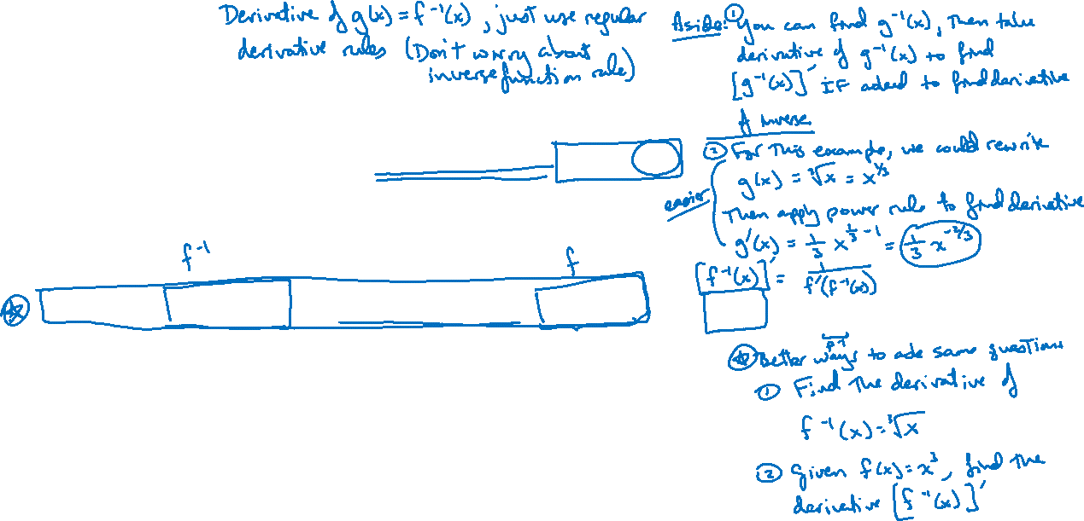

Slide 5
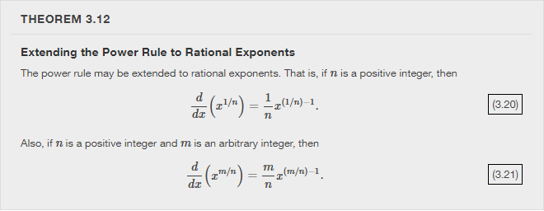


Slide 6
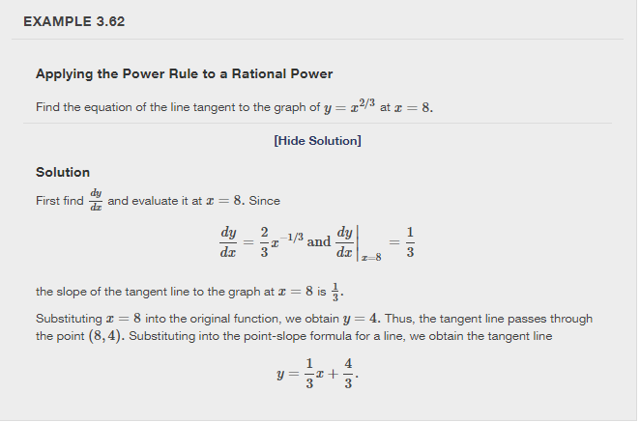
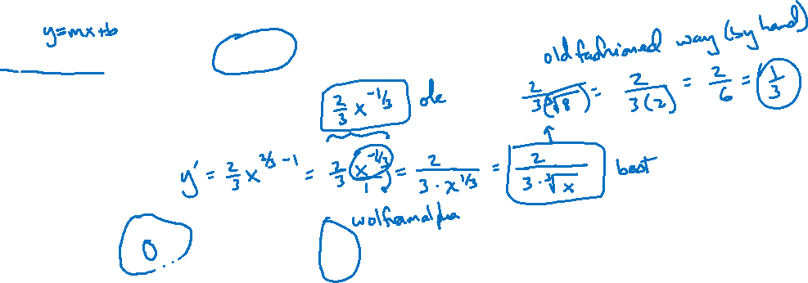

Slide 7
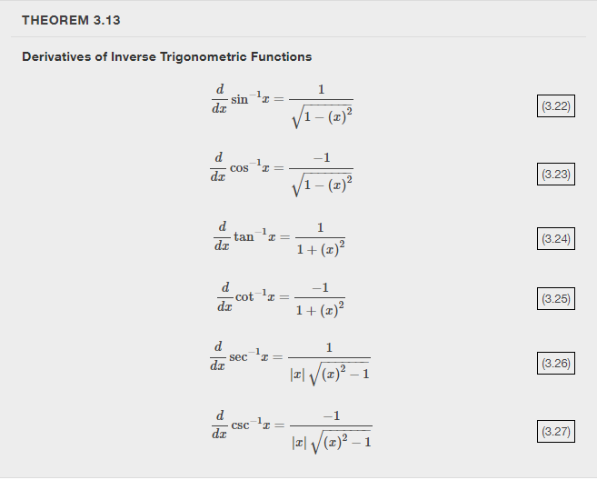

Slide 8


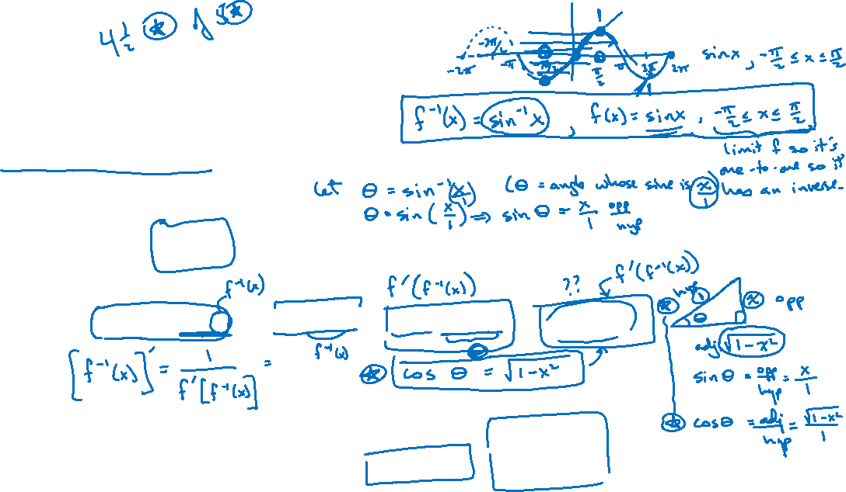

Slide 9
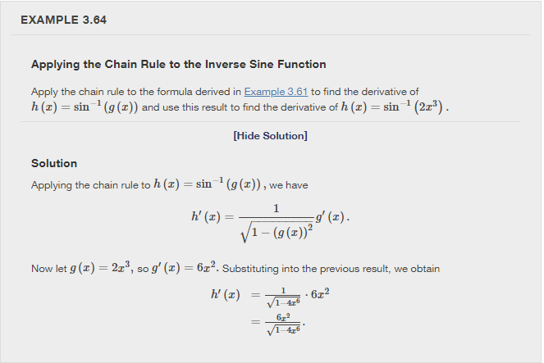
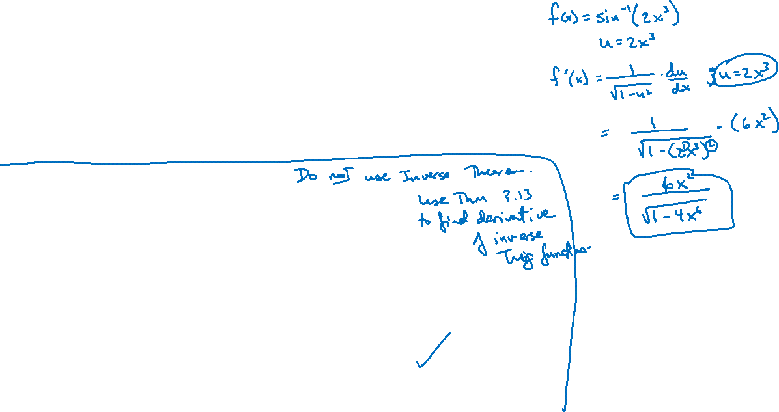

Slide 10
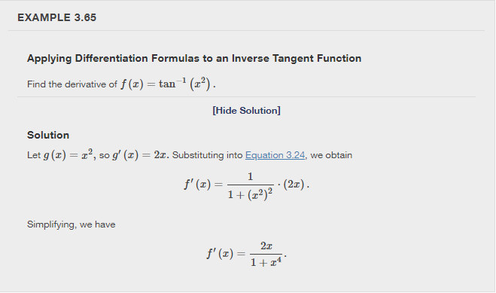
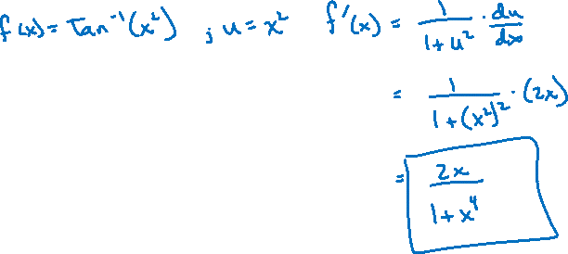

Slide 11
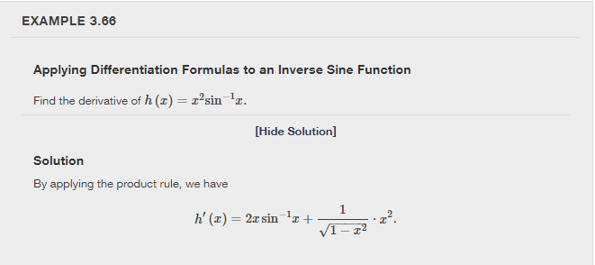
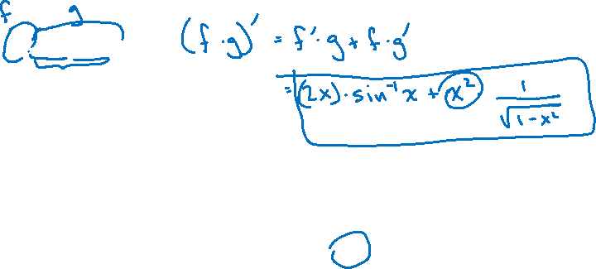

Slide 12
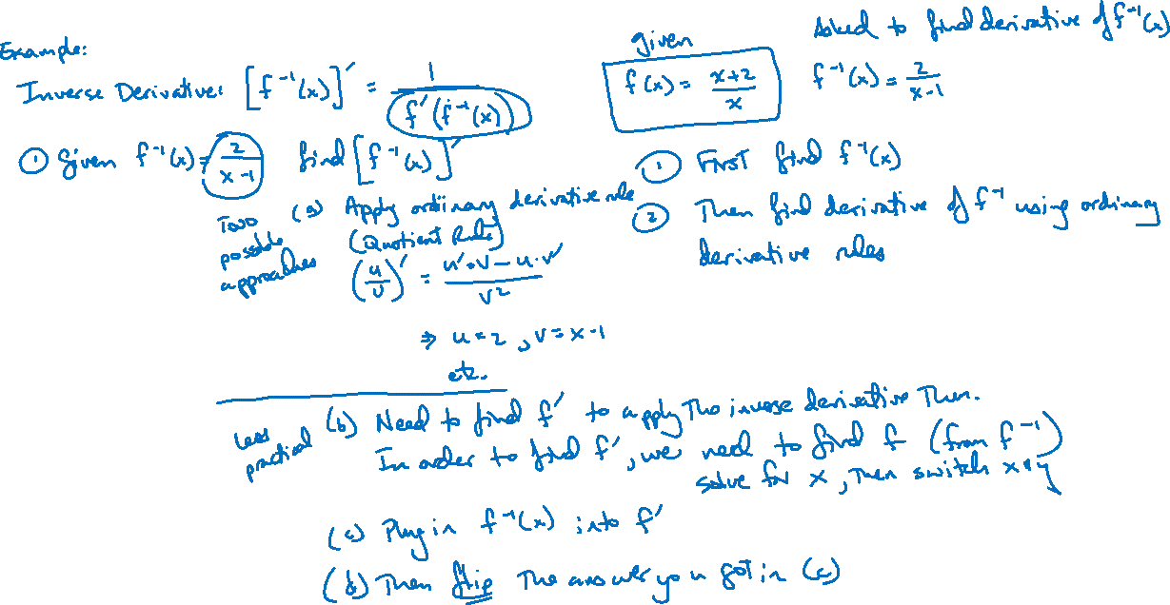
Q&A

Slide 13
Thank you!

